Slide 1
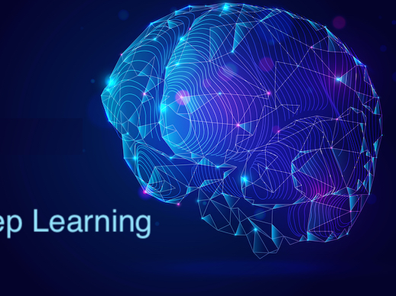
Deep Learning – Powering Modern AI
Neural Networks and Beyond
Notes:
Today we’re exploring Deep Learning — a special branch of Machine Learning that has made huge breakthroughs in speech recognition, image processing, and natural language understanding. We’ll look at what it is, how it works, where it’s used, and why it’s different from traditional ML.

Slide 2
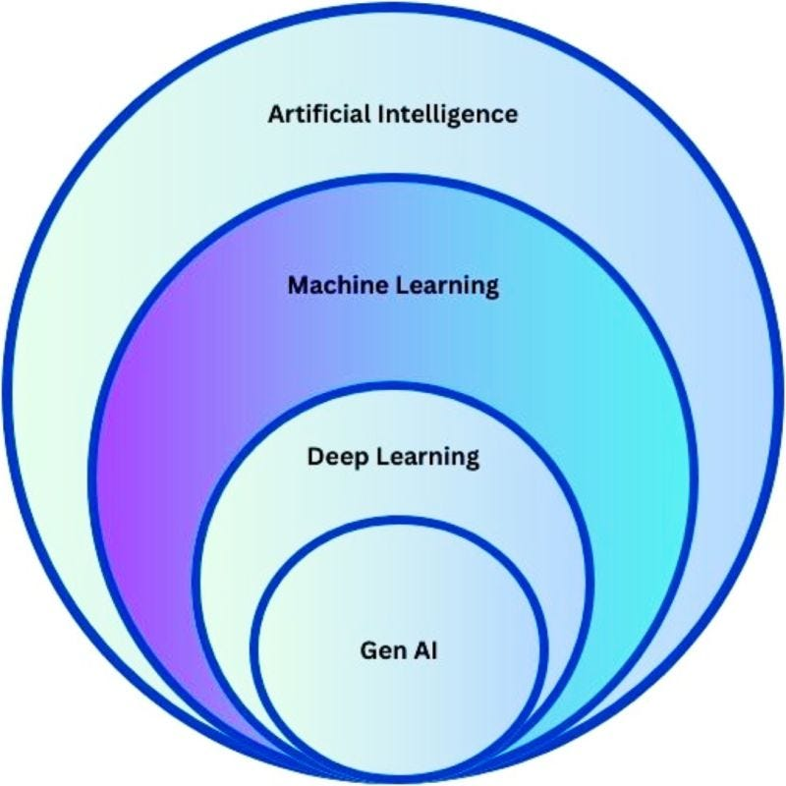

Slide 3
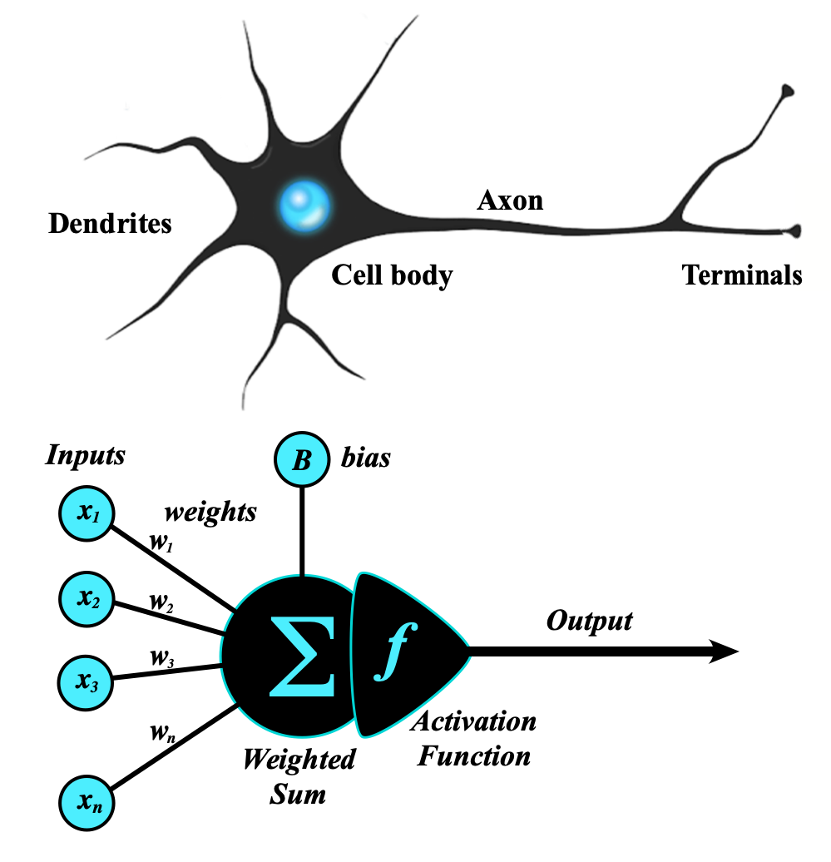
Artificial Neuron
An artificial neuron takes multiple inputs and assigns weights to them.
It adds the weighted inputs and a bias, then passes the result through an activation function.
The final output helps the neural network learn patterns and make predictions.
Notes:
Deep Learning is a special branch of Machine Learning inspired by how our brain’s neurons work.
It uses networks with many layers — that’s why it’s called ‘deep’.
Deep Learning powers speech recognition, facial recognition, and the tech behind modern chatbots.
If ML is a bicycle, DL is a sports car — faster, more powerful, but needing more data and fuel.

Slide 4
What is Deep Learning?
Definition: A subset of Machine Learning that uses multi-layered neural networks to automatically learn complex patterns from large amounts of data.
Notes:
Deep Learning is inspired by how the human brain processes information. It uses layers of ‘artificial neurons’ to learn directly from data. The word deep refers to having many layers — the more layers, the more complex patterns it can learn.

Slide 5
Multi Layer Network

Slide 6
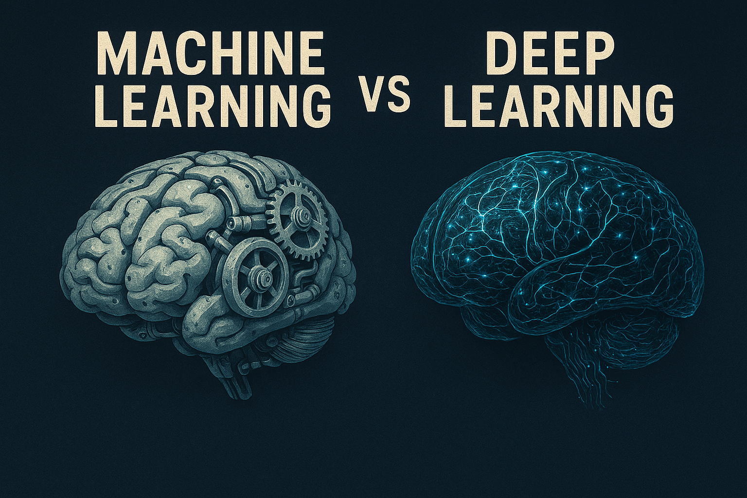
ML vs DL
ML vs DL Comparison:
Data Requirement: ML – smaller datasets; DL – huge datasets
Feature Engineering: ML – manual; DL – automatic
Processing Power: ML – moderate; DL – high (GPUs)
Examples: ML – spam detection; DL – image recognition
Notes:
Machine Learning can work with smaller data and often requires humans to decide which features are important. Deep Learning needs more data and computing power, but it can automatically learn features — this makes it more powerful for unstructured data like images, audio, and text.

Slide 7
How a Neural Network Works
Neural Network Structure:
Input Layer → Hidden Layers → Output Layer
Each connection has a weight
Learns weights during training
Example: Predicting if a photo is a cat or dog
Notes:
A neural network takes inputs, passes them through layers of neurons, and produces an output. Each connection has a weight — the network learns these weights during training. For example, to detect if an image is a cat or dog, neurons might detect shapes, patterns, and colors, and combine that knowledge to decide.

Slide 9
Training Deep Learning Models
Training Steps:
1. Input data
2. Forward pass
3. Compare prediction to correct answer (loss)
4. Adjust weights (backpropagation)
5. Repeat until accurate
Notes:
Training is like trial and error at high speed. The model makes a guess, checks how far off it is, and adjusts its internal settings. This happens millions of times until the model becomes accurate.

Slide 10
Common DL Architectures
DL Architectures:
CNN (Convolutional Neural Network): for images
RNN (Recurrent Neural Network): for sequences like text or speech
Transformers: for language understanding (used in LLMs)
Notes:
Different architectures suit different problems: CNNs excel at vision tasks. RNNs work well with sequences, like language or time series. Transformers, which we’ll discuss more in the LLM session, are the current state-of-the-art for NLP.

Slide 11

Working of CNN

Slide 12


Slide 13
Why Deep Learning Works So Well
Strengths of DL:
Handles unstructured data (images, audio, text)
Learns features automatically
Scales with more data and computation
Notes:
Deep Learning shines because it can learn directly from raw data, no hand-crafted rules needed. And with more data, it keeps getting better. Pre-trained models can even transfer knowledge from one task to another.

Slide 14


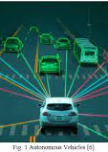
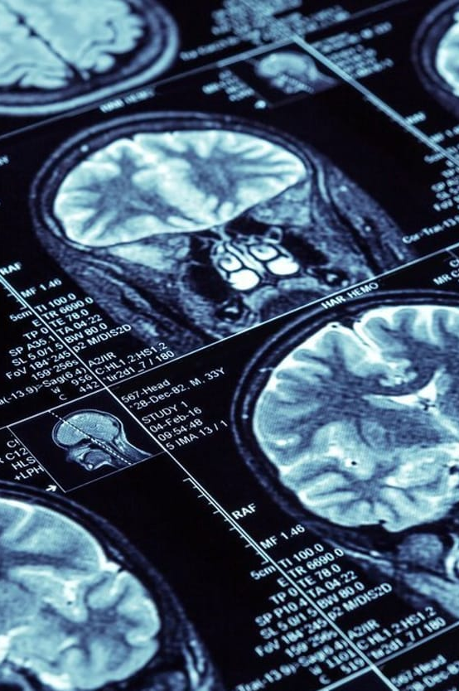
Real-World Applications
DL Applications:
Image recognition in healthcare (detecting diseases)
Speech recognition (Siri, Alexa)
Self-driving cars (object detection)
Notes:
DL is behind many AI breakthroughs: diagnosing diseases from scans, powering smart assistants, making self-driving cars see, and enabling instant translation.

Slide 15
Challenges in Deep Learning
Challenges:
Needs a lot of data
Requires high computing power (GPUs/TPUs)
Often a ‘black box’ (hard to explain decisions)
Risk of bias in training data
Notes:
DL isn’t perfect — it’s data-hungry and resource-intensive. It can be a black box, meaning it’s hard to explain why it made a decision, and if your data has bias, the model will too.

Slide 16
Recap
Summary:
Deep Learning = ML with multi-layered neural networks
Best for unstructured, complex data
CNNs, RNNs, Transformers for different tasks
Powerful but data and compute intensive
Notes:
In short: DL is ML on steroids — it handles complex, unstructured data incredibly well, but comes with big requirements for data, compute, and transparency.

Slide 17
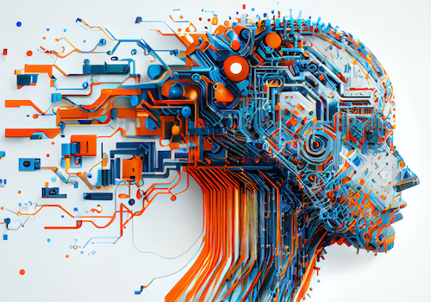
Next Session
Next: Generative AI – From Data to Creativity
How AI creates new content
Notes:
Now that we understand the engine, in the next session we’ll see how AI uses it to create — that’s where Generative AI comes in.

